Slide 1
U.S. COUNTIES COVID 19 DATA
2020 JAN - 2021 FEB

Slide 2
Problem Statement
To analyze the data set of US Counties Covid cases from January 21 2020 to February 20 2021.

Slide 3
DATA SET
Given data set consists of nearly 11 lakh rows and 6 attributes (date, country, state, FIPS (Federal Information Processing Standard) code, cases, deaths). This dataset tracks the early reported cases and deaths of COVID-19 in the United States, providing information on the daily progression of cases across different counties and states from January 21, 2020, to February 20, 2021

Slide 4
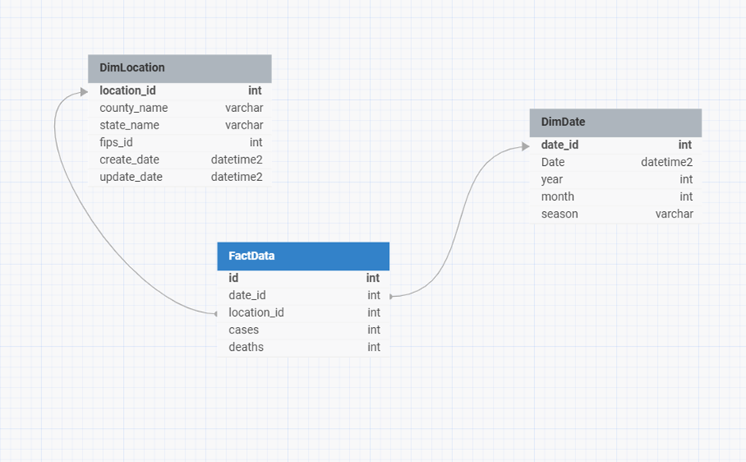
DATABASE DESIGN
Dimension tables: DimDate, DimLocation ( fips_id ,county ,state as a set is unique)
Fact table: FactData

Slide 5
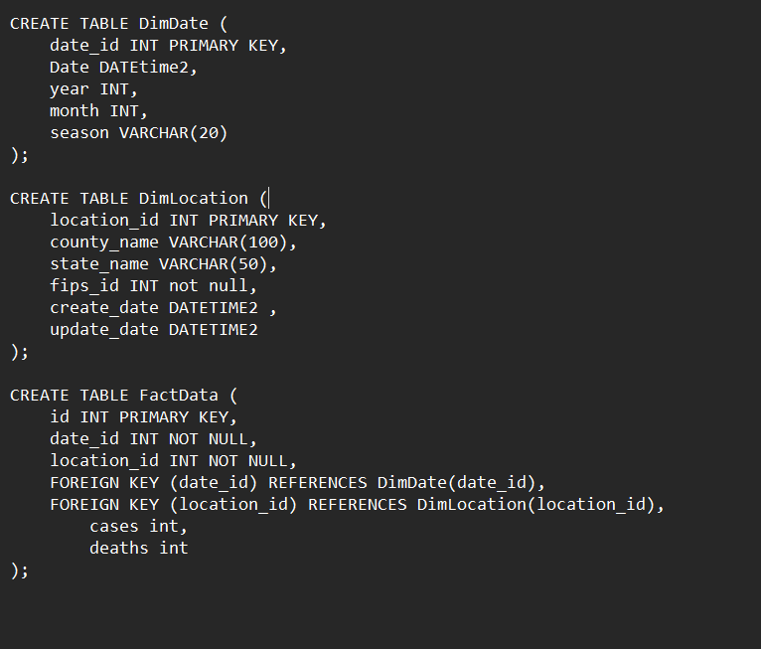
Data Base Design

Slide 6
Mappings

Slide 7
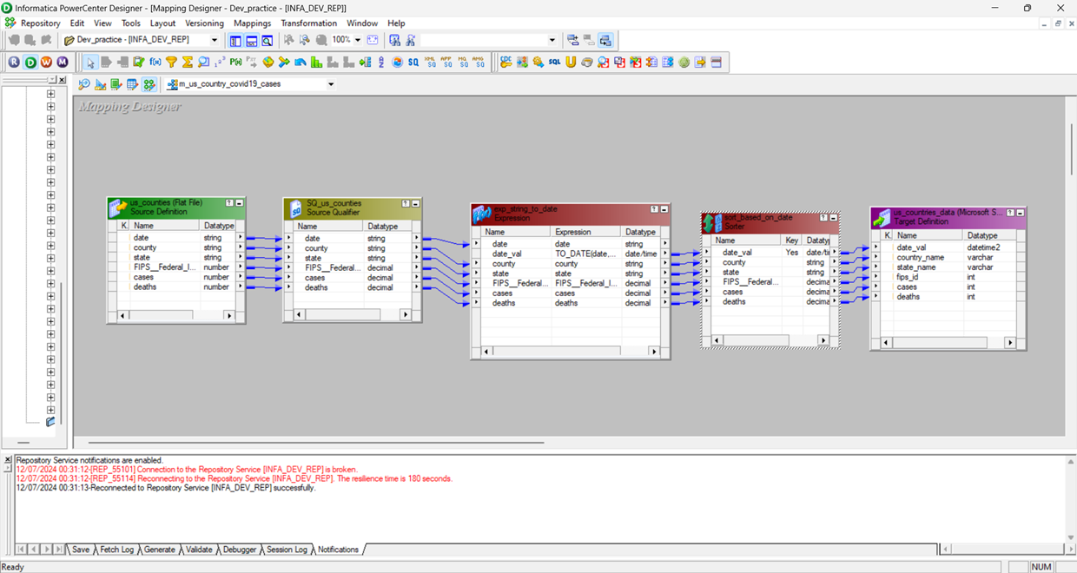
loading csv data to staging

Slide 8
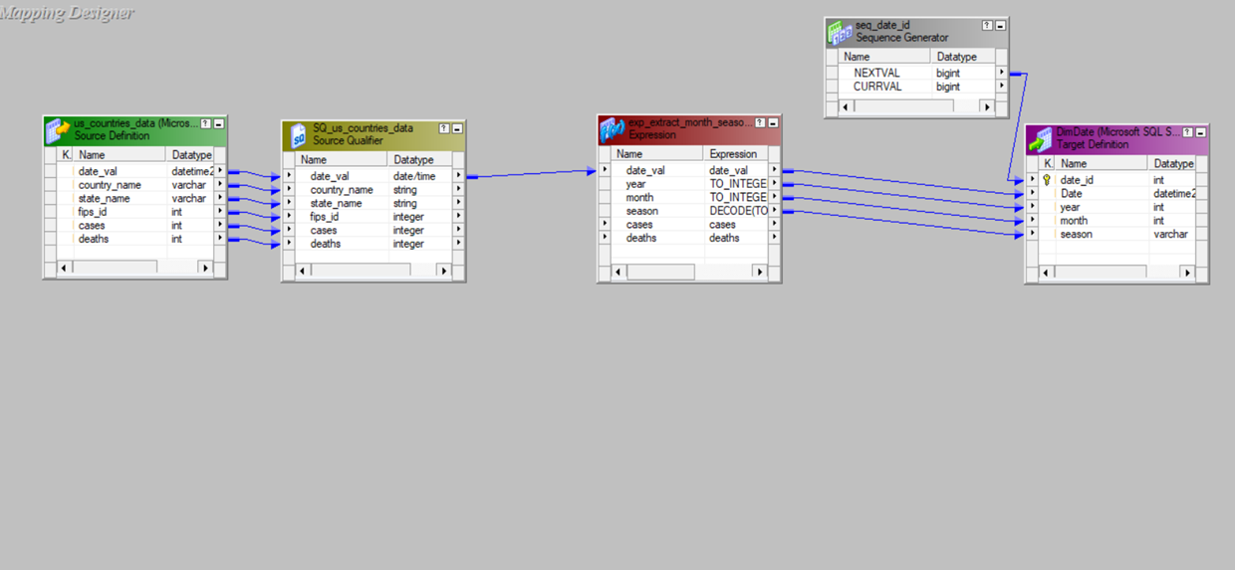
Dim Date- Insert Strategy

Slide 9
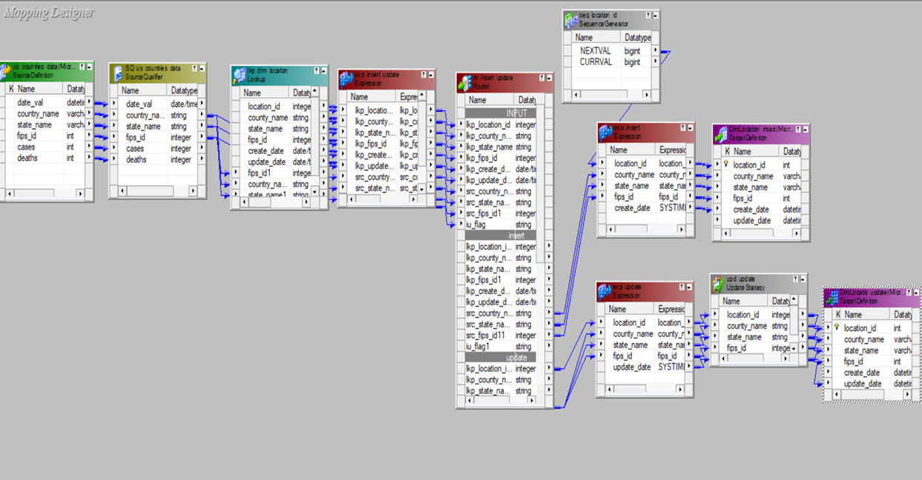
Dim Location- SCD1

Slide 10
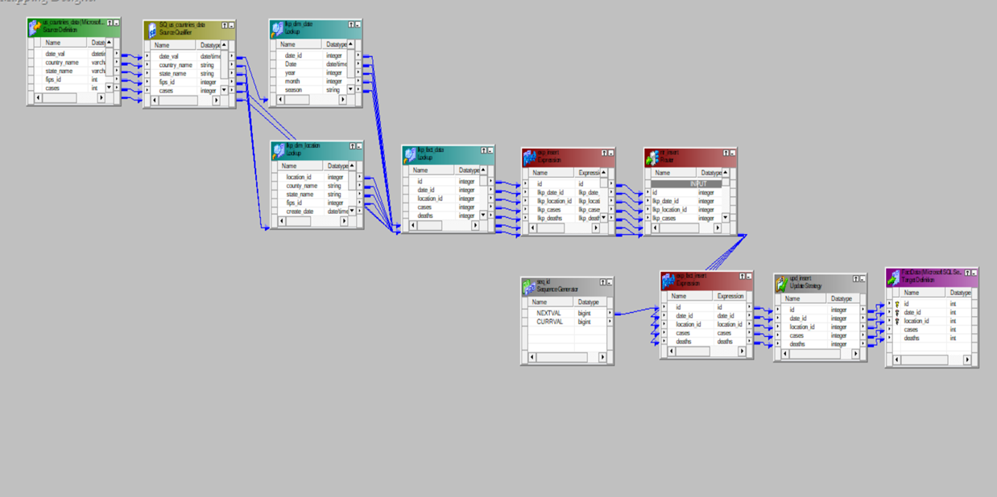
Fact Data - SCD1 Insert

Slide 11
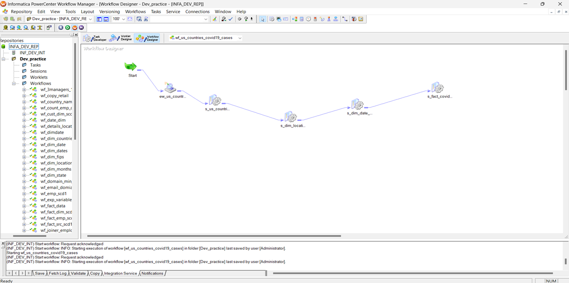
Work Flow

Slide 12
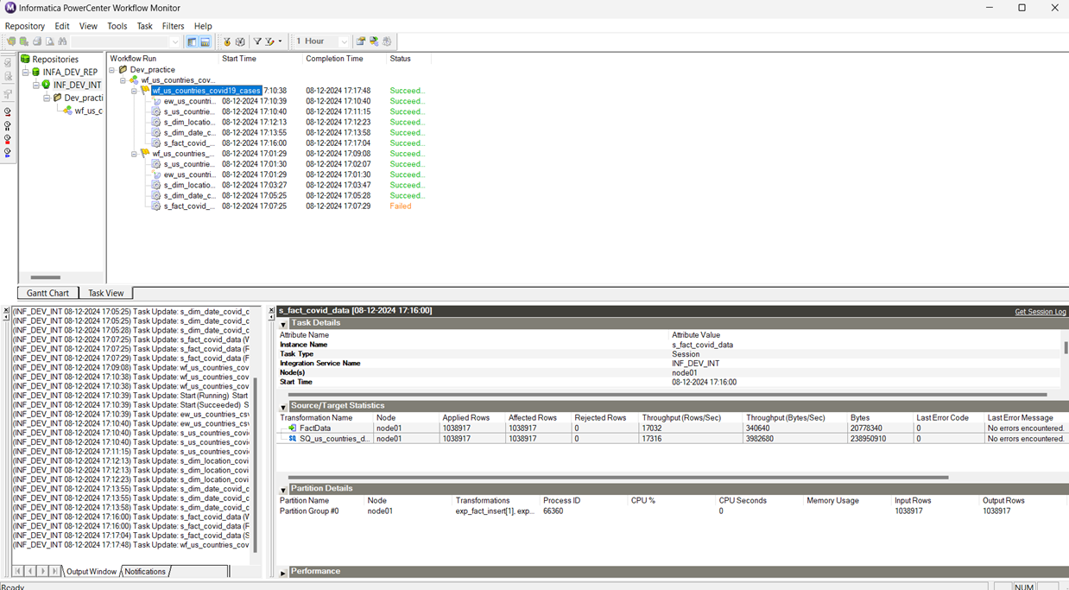
Workflow Monitor

Slide 13
VISUALIZATIONS

Slide 14
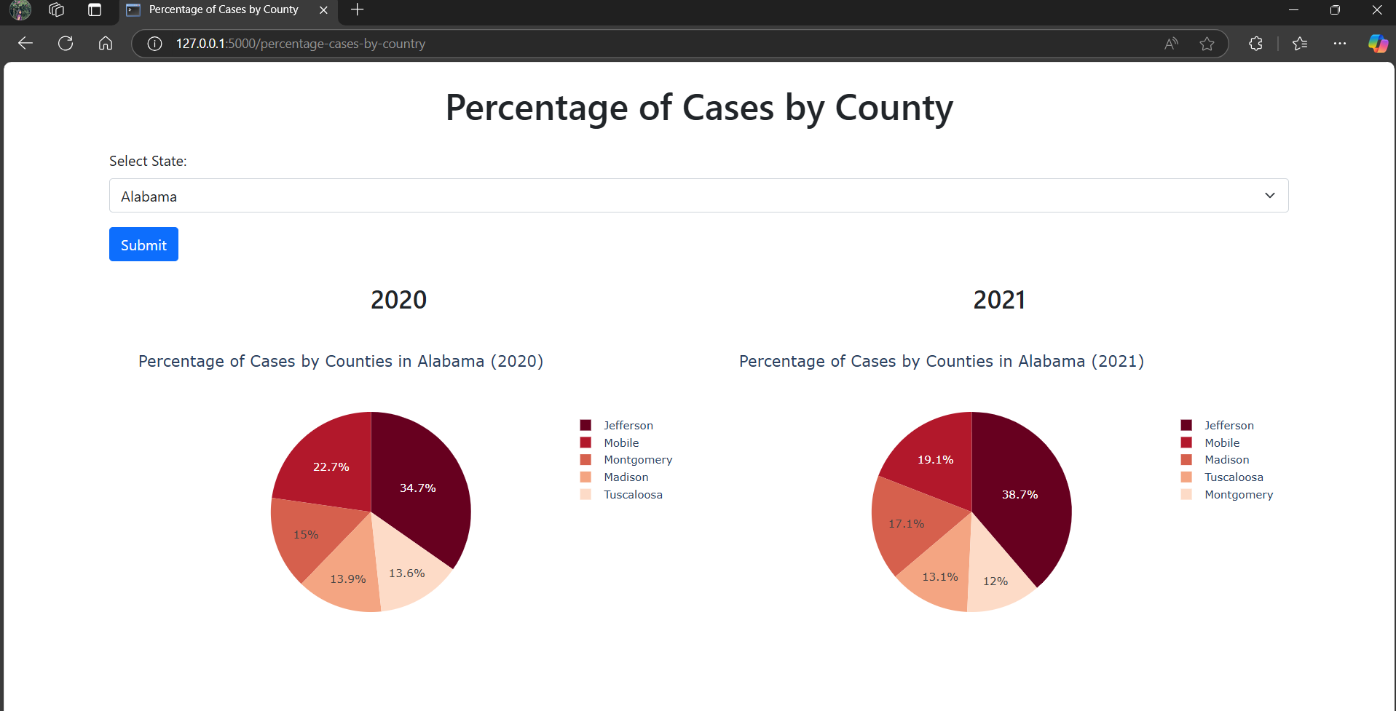
By analyzing the distribution of cases across different counties
Search based analysis based on selected State top 5 counties with highest cases are shown

Slide 15
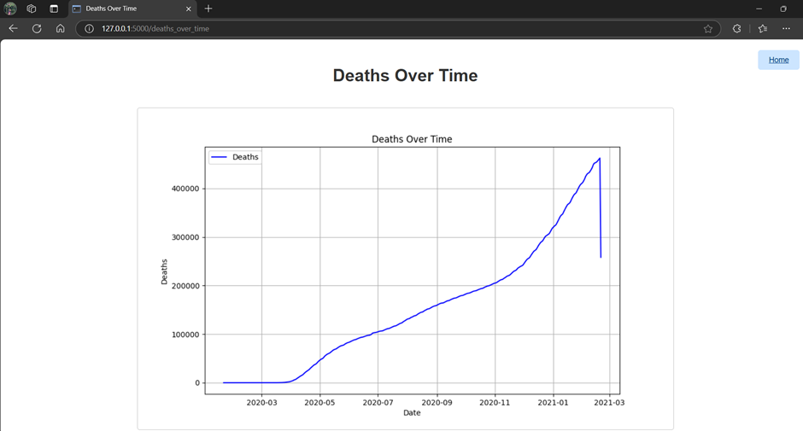
time-series data like this, the company can forecast potential future trends

Slide 16
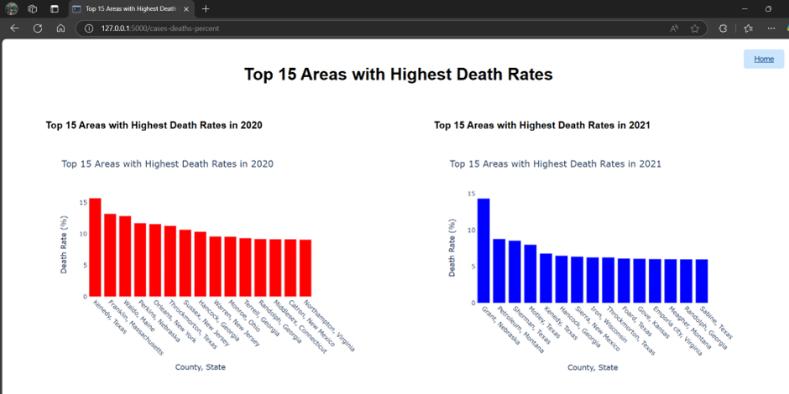
Company assess geographic risk profiles, This data can guide underwriting policies,premium adjustments

Slide 17
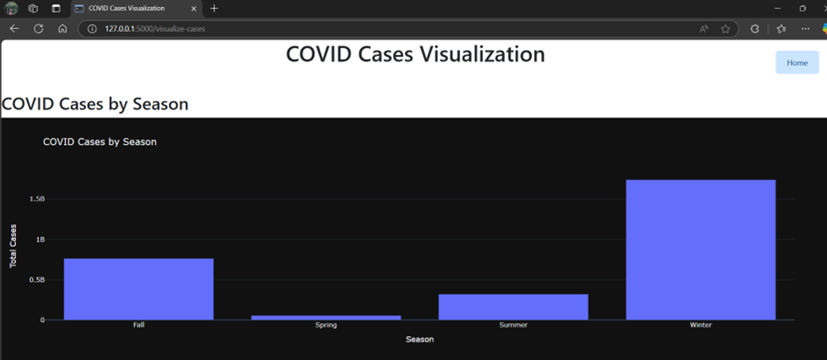
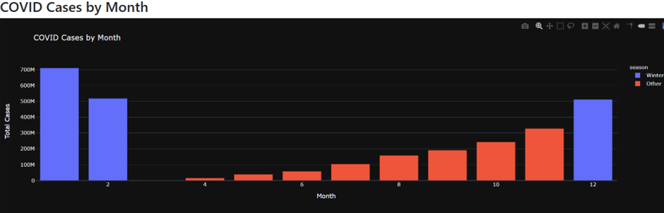
short-term health policies, month-wise or seasonal premiums

Slide 18
Future scope
Increase the time line for analysis and also consider different metrics of people conditions like cases, deaths, hospitalized, Vaccination etc.
Integrate government and public health data.
Percentage of cases/deaths involving pre-existing conditions.
Number of recovered cases and time to recovery.

Slide 19
THANK YOU
Challa Vyshnavi Reddy

